Slide 1

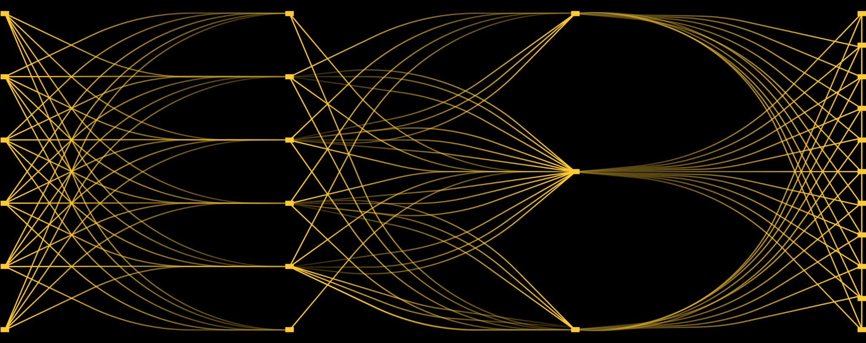
MLOps ZoomCamp: Experiment Tracking with Weight & Biases

Slide 2
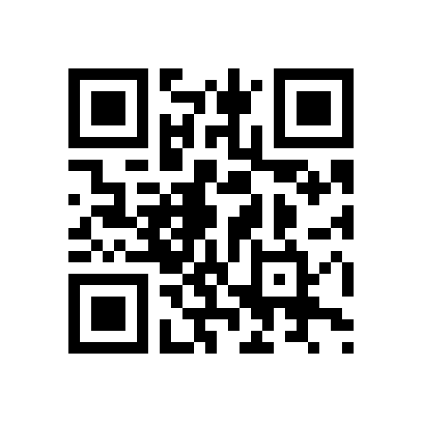
Follow along at
wandb.me/mlops-zoomcamp

Slide 3
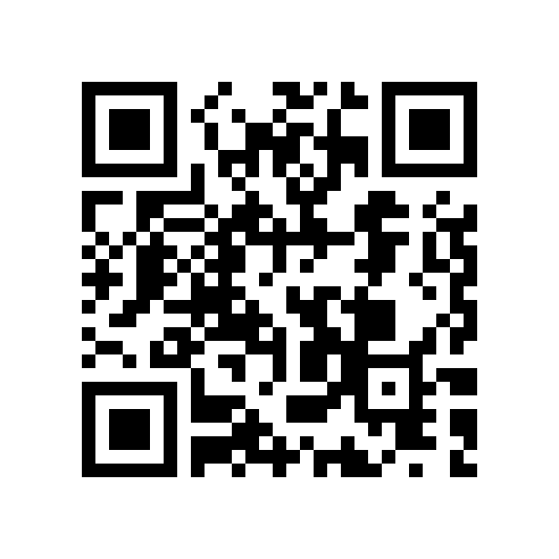
Find all code at
wandb.me/mlops-zoomcamp-github

Slide 4
Soumik Rakshit
whatamidoing$>
Developing Tools for ML practitioners
Building MLOps Pipelines for MonAI, Nvidia Gameworks, Keras, JAX…
Training Computer Vision Models on TPUs
Contributing to the Keras Ecosystem
Playing The Legend of Zelda: Tears of the Kingdom
Follow on GitHub/Twitter
Machine Learning Engineer at Weights & Biases
Google Developer Expert (JAX)

Slide 5
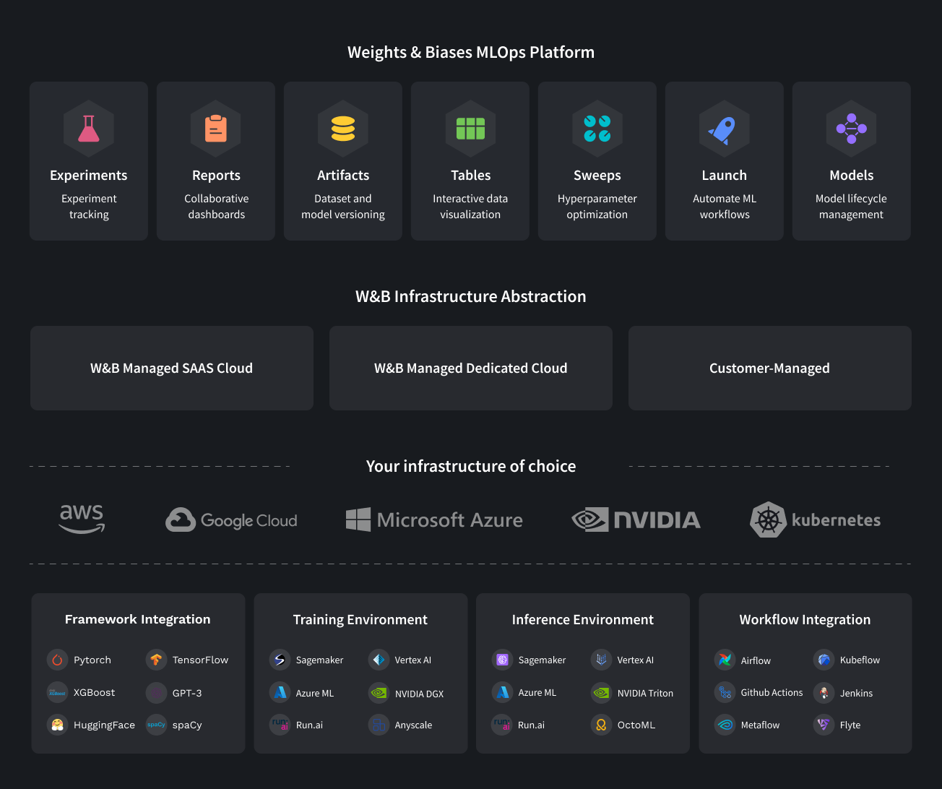
Weights & Biases - MLOps Platform

Slide 6




























The world’s leading ML teams trust us
Repeat ML Founders:
Notes:
TALK TRACK:
The world’s leading ML teams across a broad spectrum of industries trust Weights & Biases to help address their ML tooling and MLOps needs
Our founders have been in the ML space for over 15 years, having previously founded FigureEight, a premier data labeling company
We’re well funded, backed by top-tier venture capital investors, and were recently named a Cool Vendor by Gartner

Slide 7
What is an ML Experiment?

Slide 8
Machine Learning is Highly Empirical
Explore
Train
Evaluate
Fine-tune
Train again
Try something else

Slide 9
Why Track An ML Experiment?

Slide 10
Share Results
Take Business Decisions
Reproducibility

Slide 11
Tracking Experiments Traditionally

Slide 12
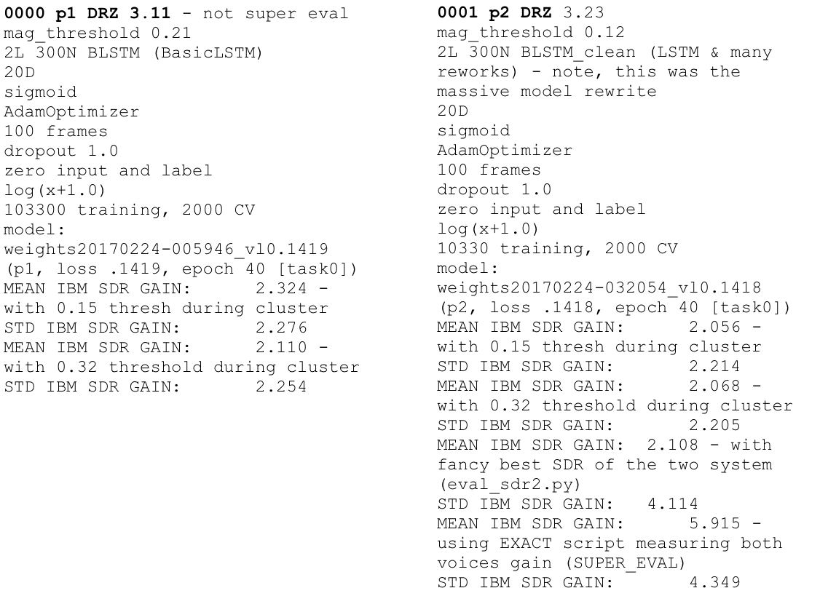

Slide 13
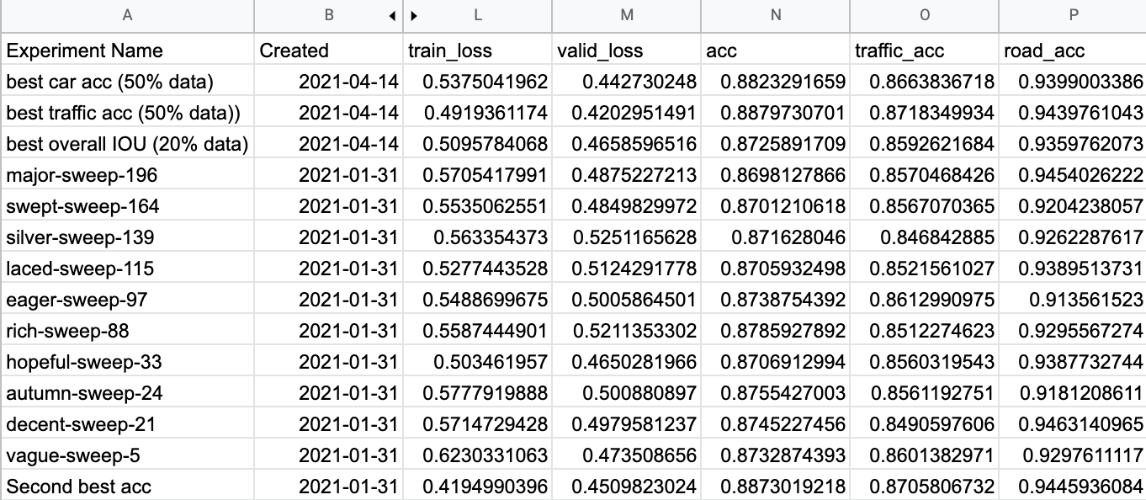

Slide 14
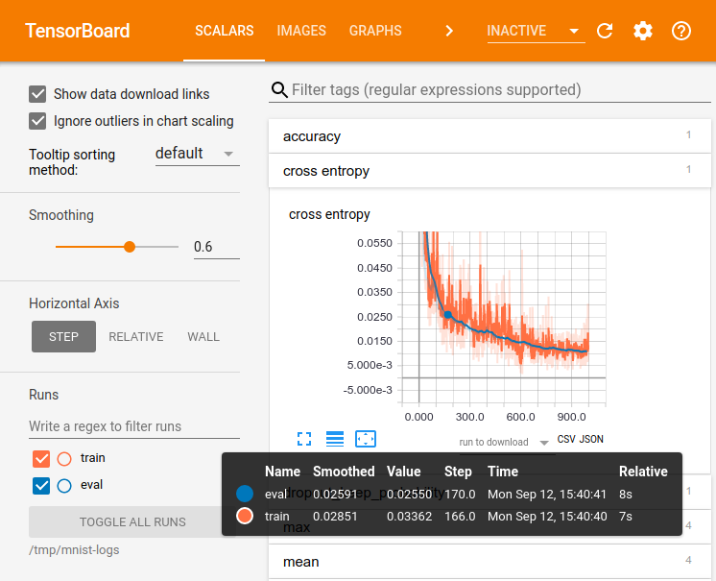

Slide 18


Slide 19

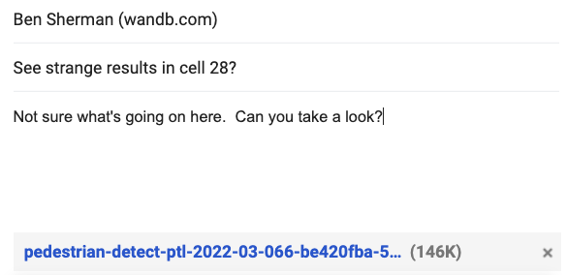

Slide 20




Slide 21


Slide 22


Slide 23


Slide 24



Slide 25
A System of Record for all ML Workflows

Slide 27
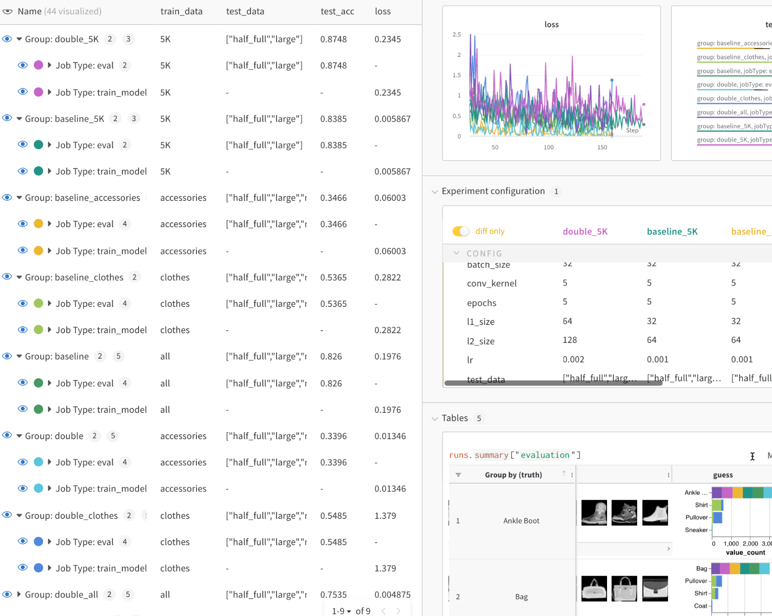

Slide 28
!pip install wandb # Install W&B
wandb.init() # Start experiment
wandb.log(metrics) # Log metrics + more!

Slide 29
Time for a Demo!!!

Slide 30




Slide 31
Asking Questions about Your Data and Model

Slide 32
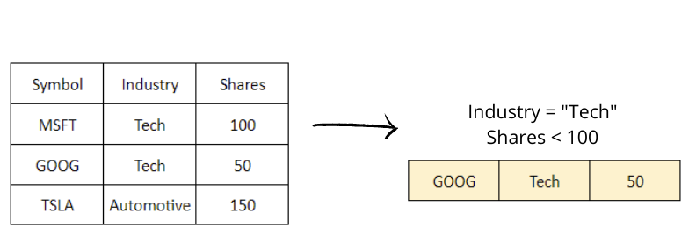
Filter df.loc[...]

Slide 33
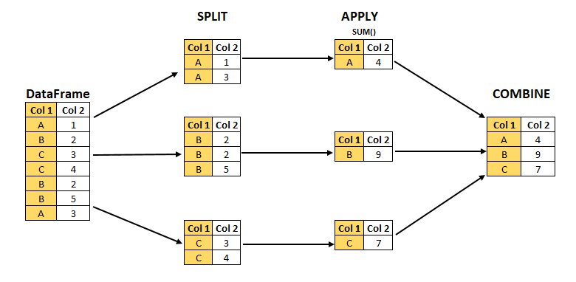
Filter df.loc[...]
Split-Apply-Combine df.groupby(...).agg(...)

Slide 34
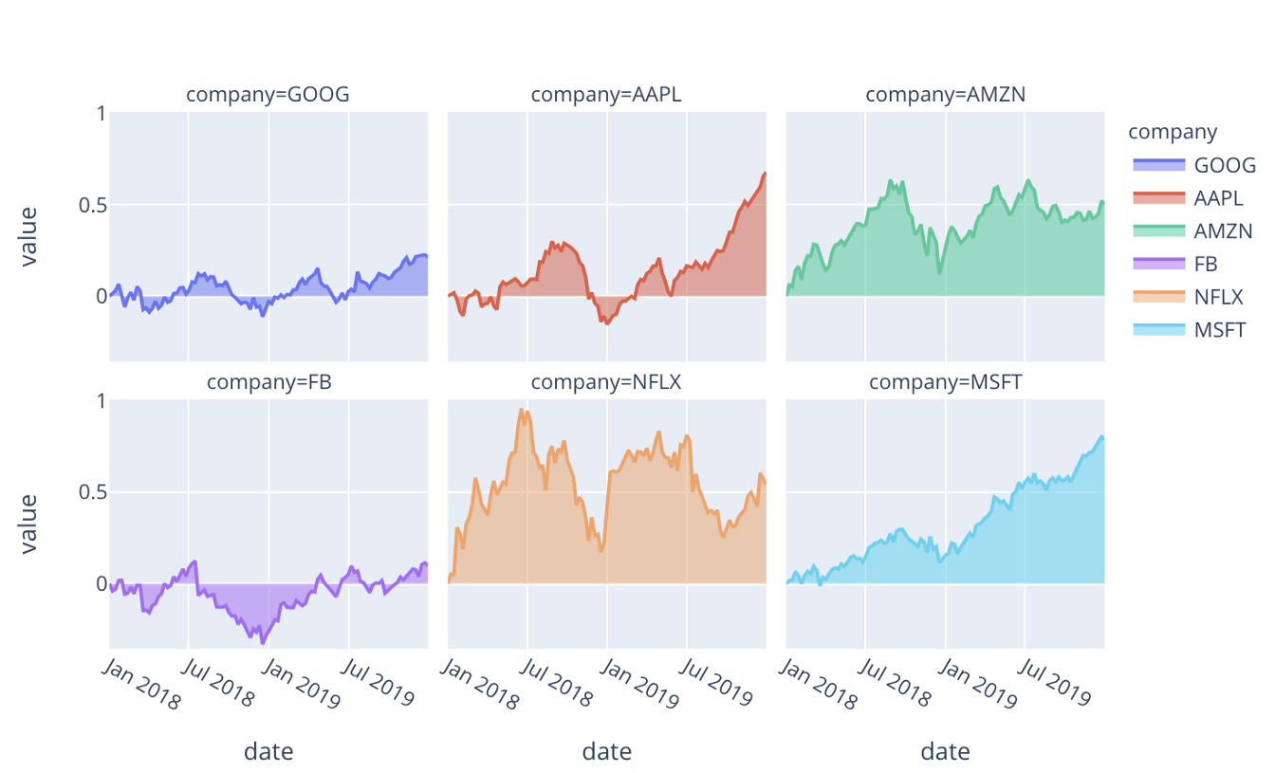
Filter df.loc[...]
Facet / Plot df.plot(...)
Split-Apply-Combine df.groupby(...).agg(...)

Slide 35

Interactive Dataframes with Rich Media Support…
wandb.Table

Slide 36
Time for a Demo!!!

Slide 37
Training Better Models

Slide 38
Asking Questions about Training

Slide 39

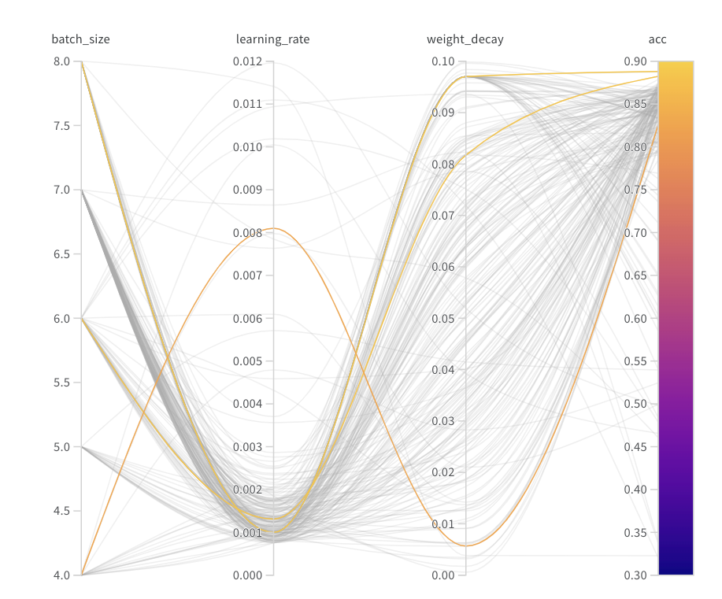
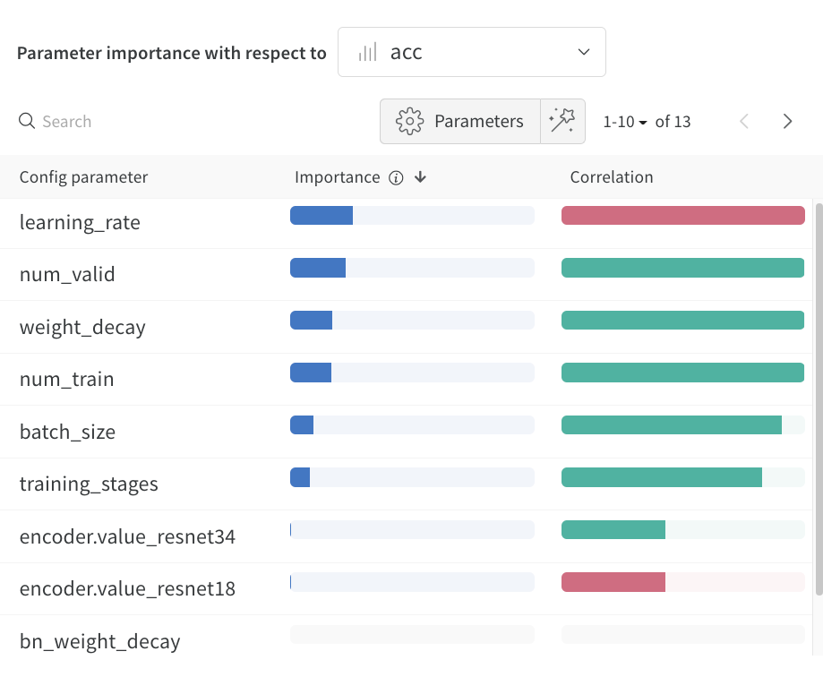
Sweeps
Easily and systematically search hyperparameters

Slide 40
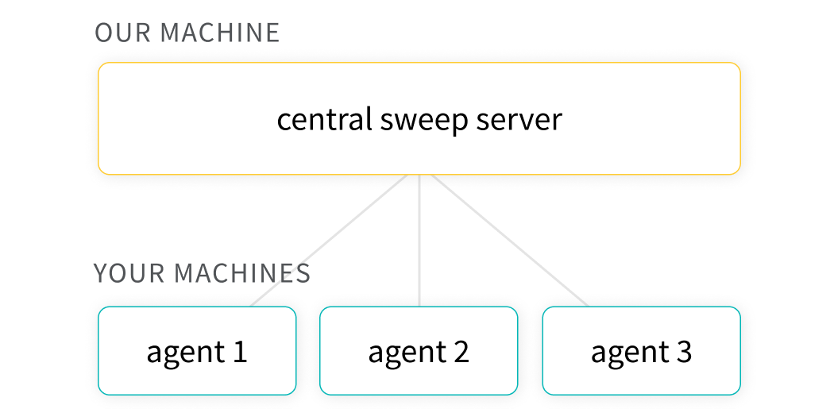
Sweeps – Easily search hyperparameters
Ask questions about your data (and models)
program: train.py
method: bayes
metric:
name: valid_loss
goal: minimize
parameters:
batch_size:
values: [32, 64]
mixup_alpha:
values: [0.2, 0.5, 0.8]
optimizer:
values: ["adam", "ranger"]
encoder:
values: ["resnet18", "resnet34", "resnet50", "resnet101"]
Notes:
Saving your failures
Because everything is saved in one spot, your colleagues can learn from your mistakes
I can see what hyperparameters you tried to optimize (and how much of the space you tried to search)

Slide 41
Unified Reporting and Dashboarding

Slide 42
Sharing and Presenting Your Work

Slide 43
Time for a Demo!!!

Slide 44
How to use Weights & Biases with framework X on platform Y???

Slide 45
Integrations

Slide 46




















Fits into your workflow
Integrated into every popular ML framework
Instrumented into over 6,000 popular ML repos
Runs on every cloud or in your own infra
Notes:
TALK TRACK:
Weights & Biases is designed to work within your workflow
We’re infrastructure-agnostic, run on all major clouds, and even in your own infrastructure
We’re partnered with Amazon, Google Cloud, Azure, and Nvidia’s Base Command Platform
We have integrations with every popular ML framework. Whether your team loves Pytorch or Tensorflow, JAX or SciKit Learn, Hugging Face or SpaCy: Weights & Biases will work for them
Further, we’re also instrumented in over 6 thousand machine learning repositories, including some of the most popular like Yolo, Detectron, Nvidia’s NEMO, and more.
DISCOVERY QUESTIONS:
What cloud do you run your ML workloads on?
What ML frameworks do you use?

Slide 47
How do I learn more about Weights & Biases???

Slide 48
Check out Tutorials:
docs.wandb.ai/tutorials

Slide 49
Read ML Reports at:
wandb.ai/fully-connected

Slide 50
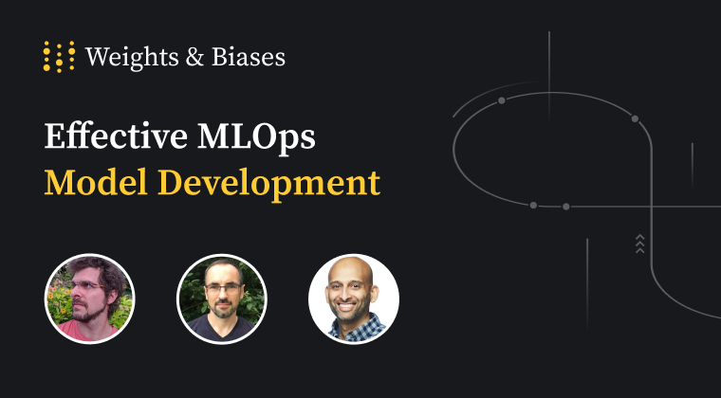
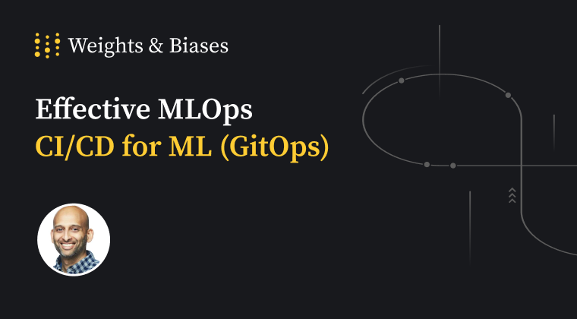
The W&B Courses:
www.wandb.courses
Model Development, CICD, LLMs(upcoming)
Free courses with a certificate!

Slide 51
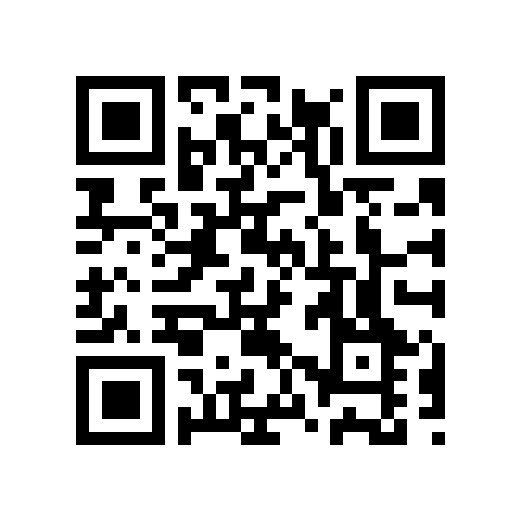
Time for some Homework!!!
wandb.me/mlops-zoomcamp-quiz
Winners get 🪄🐝 Swags 😎
Submit by 6 June, 23:00 (Berlin time)

Slide 52
Questions???

Slide 53
Thank You 🙏

